Slide 1
Week 12 .2 – Term Project
Exploratory Analysis of NETFLIX Movies and TV shows
Professor: Dr. Neerja Sahu , PhD
Karthikeya Chellamuthu
DSC530-T302
03/05/2022
Week 12 .2 – Term Project

Slide 2
Contents
Introduction
Statistical questions
Important variables
Exploratory Data Analysis
Conclusion

Slide 3
Introduction
Netflix needs no introduction, it is a streaming service that allows members to watch a wide variety of contents like movies, TV shows, documentaries and more. Netflix allows us to enjoy unlimited ad-free viewing of the contents. It was founded in 1997 and has become $176 billion as of Jan 21 company in 25 years.
Netflix is one of the most popular media and video streaming platforms. They have over 8000 movies or tv shows available on their platform, as of mid-2021, they have over 200M Subscribers globally. The tabular dataset consists of listings of all the movies and tv shows available on Netflix, along with details such as - cast, directors, ratings, release year, duration.
Due to pandemic many people sitting at home and started watching more tv and gaming stuffs. Additional important variables will be analyzed to perform exploratory data analysis and also predict the number of Movies and TV shows that will be added in 2022.

Slide 4
Statistical questions
Analyze the contents available in different countries and see which countries produce more movies and TV shows.
In which month are the contents added more?
What is the duration of the contents?
What are the top categories or genre?
What are the types of contents and their rating?
How many contents will be added in 2022?

Slide 5
Important variables
Type – It is the type of content Movies/TV Shows
Country – It is the place where contents are present
Date_added – Date when the contents were added to Netflix
Release_year – Year when the Movies/TV shows were released
Rating – It represents the content type. For example TV-MA is for adults only and may not be suitable for children under 17; TV-G is suitable for all ages.
Listed_in – It is the genre. Example: Comedies, Kid’s TV

Slide 6
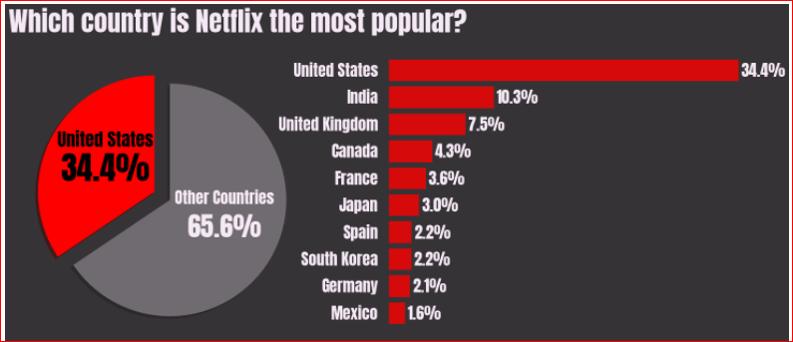
Contents present based on country

Slide 7
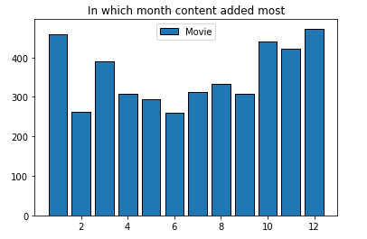
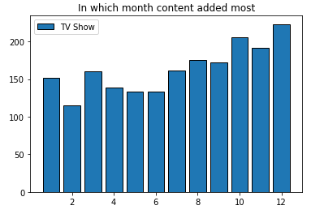
Contents added by month

Slide 8
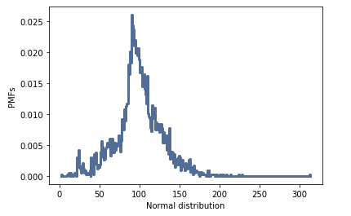
Duration of contents present

Slide 9
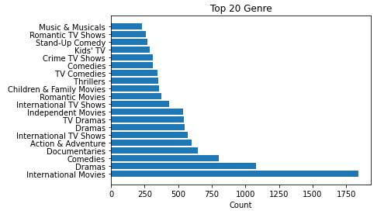
Contents based on genre

Slide 10
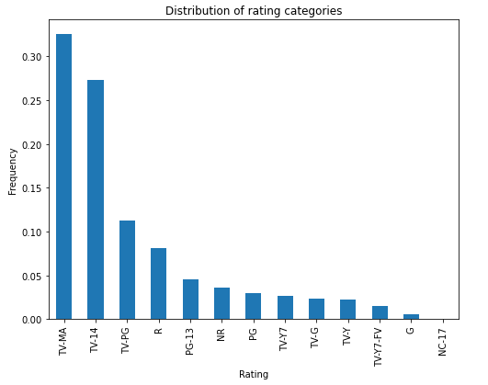
Distribution of rating

Slide 11
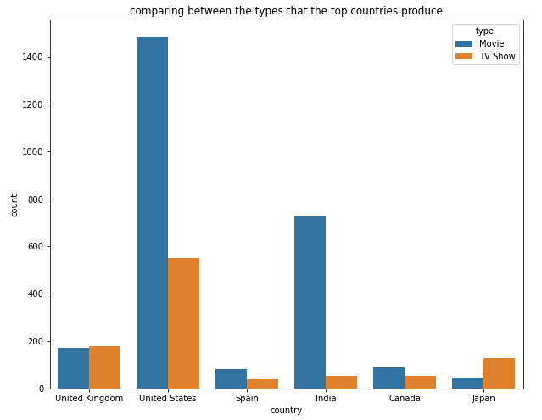
Movies and TV shows added by top countries

Slide 12
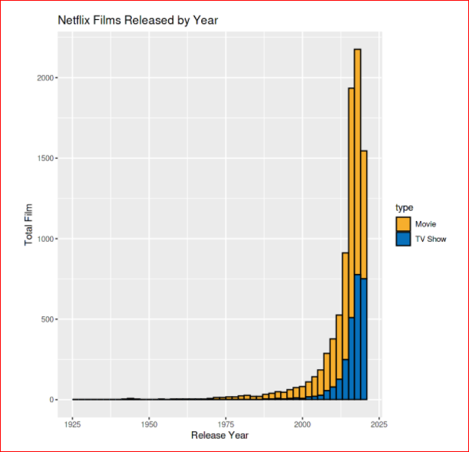
Prediction
Based on the prediction – 1023 Movies and 958 TV Shows will be added in 2022

Slide 13
THANK YOU

